Slide 1
Pattern Classification
All materials in these slides were taken from
Pattern Classification (2nd ed) by R. O. Duda, P. E. Hart and D. G. Stork, John Wiley & Sons, 2000
with the permission of the authors and the publisher

Slide 2
Chapter 3:
Maximum-Likelihood & Bayesian Parameter Estimation (part 1)
Introduction
Maximum-Likelihood Estimation
  Example of a Specific Case
  The Gaussian Case: unknown μ and σ
  Bias
Appendix: ML Problem Statement

Slide 3
Introduction
  Data availability in a Bayesian framework
    We could design an optimal classifier if we knew:
      P(ω_{i}) (priors)
      P(x | ω_{i}) (class-conditional densities)
    Unfortunately, we rarely have this complete information!
  Design a classifier from a training sample
    No problem with prior estimation
    Samples are often too small for class-conditional estimation (large dimension of feature space!)
1

Slide 4
  A priori information about the problem
  Normality of P(x | ω_{i})
    P(x | ω_{i}) ~ N( μ_{i}, Σ_{i})
    Characterized by 2 parameters
  Estimation techniques
    Maximum-Likelihood (ML) and the Bayesian estimations
    Results are nearly identical, but the approaches are different
1

Slide 5
    Parameters in ML estimation are fixed but unknown!
    Best parameters are obtained by maximizing the probability of obtaining the samples observed
    Bayesian methods view the parameters as random variables having some known distribution
    In either approach, we use P(ω_{i} | x)
    for our classification rule!
1

Slide 6
Maximum-Likelihood Estimation
    Has good convergence properties as the sample size increases
    Simpler than any other alternative techniques
  General principle
    Assume we have c classes and
    P(x | ω_{j}) ~ N( μ_{j}, Σ_{j})
    P(x | ω_{j}) ≡ P (x | ω_{j}, θ_{j}) where:
2

Slide 7
    Use the information
    provided by the training samples to estimate
    θ = (θ₁, θ₂, …, θ_{c}), each θ_{i} (i = 1, 2, …, c) is associated with each category
    Suppose that D contains n samples, x₁, x₂,…, x_{n}
    ML estimate of θ is, by definition the value that maximizes P(D | θ)
    “It is the value of θ that best agrees with the actually observed training sample”
2

Slide 8
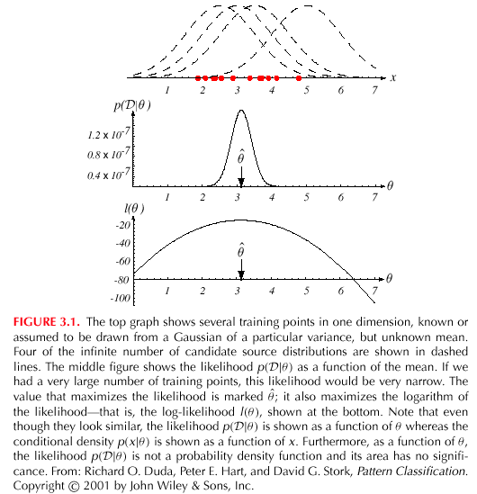
2

Slide 9
    Optimal estimation
      Let θ = (θ₁, θ₂, …, θ_{p})^{t} and let ∇_{θ} be the gradient operator
      We define l(θ) as the log-likelihood function
      l(θ) = ln P(D | θ)
      New problem statement:
      determine θ that maximizes the log-likelihood
2

Slide 10
    Set of necessary conditions for an optimum is:
    ∇_{θ}l = 0
2

Slide 11
Example of a specific case: unknown μ
  P(x_{i} | μ) ~ N(μ, Σ)
  (Samples are drawn from a multivariate normal population)
  θ = μ therefore:
    The ML estimate for μ must satisfy:
2

Slide 12
    Multiplying by Σ and rearranging, we obtain:
    Just the arithmetic average of the samples of the training samples!
Conclusion:
    If P(x_{k} | ω_{j}) (j = 1, 2, …, c) is supposed to be Gaussian in a d-dimensional feature space; then we can estimate the vector
    θ = (θ₁, θ₂, …, θ_{c})^{t} and perform an optimal classification!
2

Slide 13
ML Estimation:
  Gaussian Case: unknown μ and σ
  θ = (θ₁, θ₂) = (μ, σ²)
2

Slide 14
Summation:
Combining (1) and (2), one obtains:
2

Slide 15
Bias
  ML estimate for σ² is biased
  An elementary unbiased estimator for Σ is:
2

Slide 16
Appendix: ML Problem Statement
  Let D = {x₁, x₂, …, x_{n}}
  P(x₁,…, x_{n} | θ) = Π^{1,n}P(x_{k} | θ); |D| = n
  Our goal is to determine (value of θ that makes this sample the most representative!)
2

Slide 17
|D| = n
.
.
.
.
x₂
x₁
.
.
x_{n}
N(μ_{j}, Σ_{j}) = P(x_{j}, ω₁)
P(x_{j} | ω₁)
P(x_{j} | ω_{k})
D₁
x₁₁
.
.
.
.
x₁₀
.
D_{k}
D_{c}
x₈
.
.
.
x₂₀
.
.
x₁
x₉
.
.
2

Slide 18
θ = (θ₁, θ₂, …, θ_{c})
Problem: find such that:
2

